Slide 1
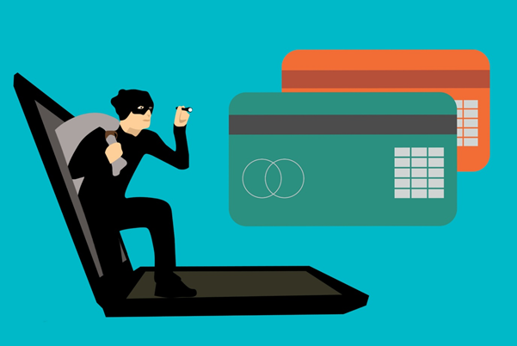
CREDIT CARD FRAUD DETECTION
Presented By : Lakshmikanth

Slide 2
LIST OF CONTENTS
1.Background
2.Objective
3. Data preprocessing & Data cleaning
4. Exploratory Data Analysis (EDA)
5.Model Building-1
6. Cost Benefit Analysis
7.Challenges
8.Conclusions
9.Recommendations
10. Root Cause Analysis

Slide 3

To develop a machine learning model to detect fraudulent transactions based on the historical transactional data of customers with a pool of merchant

Slide 4
Background
- credit card fraud is an inclusive term for fraud that is committed by criminals using a some ones payment card, such as a credit card or a debit card for buying goods and services. - Finex is a leading financial service provider based out of Florida, USA. It offers a wide range of products and business services to customers through different channels, like in-person banking and ATMs to online banking.
- In recent time the number of fraud transactions are increased drastically that leads the company huge revenue and profitability crisis

Slide 5
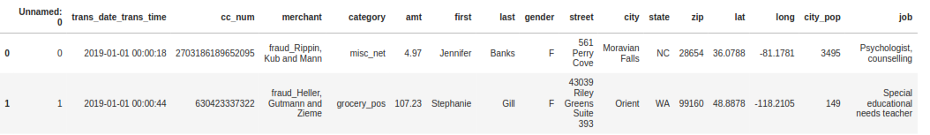

3. Understanding data & Data pre processing
Obsevered fraudTrain size :1296675,23 and fraudTest set size : 555719,23 The train and test data sets are concatenated for further operations. After combining the shape of data set is (1852394, 23) The features which dose not add value to for analysis and modelling were dropped The trans_date_trans_time column was split into two to get transaction date and transaction time separately for analysis. Basic data checks : we there is No Missing values The cities were binned as high, medium and low risk cities Time range was derived in which fraud transaction happened: 10.00 am to 4.00 pm 4.00 pm to 10.00 pm 10.00 pm to 4.00 am

Slide 6
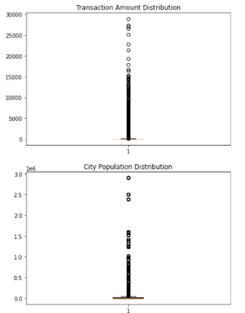
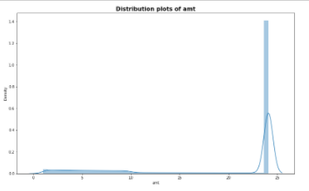
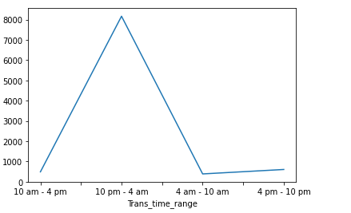
4. Exploratory data analysis
1.EDA performed and found outliers data set- (Capping method) 2.Perfomed univarient analysis 3.Perfomed Bivariate analysis 4.Skewness check The plot between the transaction time and number of fraudulent transactions suggest that the highest number of frauds happened between 10 pm to around 4:00 am. This is when the bank has to be most alert.
Univariate Analysis
Bivariate Analysis

Slide 7
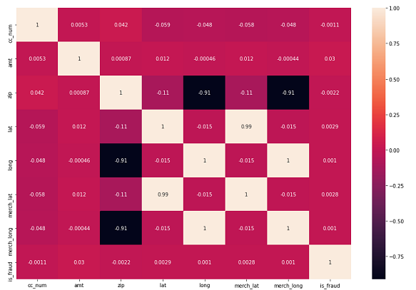
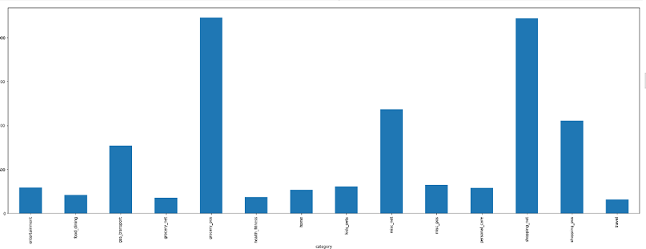
BIVARIATE ANALYSIS
correlation matrix The customer locations coordinates are highly correlating with Merchants' | The bar chart above suggests there are highest number of fraudulent transactions happening at grocery Point of Sale followed by internet shopping

Slide 8

5.Model Building
Independent variable X=credit_final_hist_new.drop('is_fraud',axis=1)
target variable is y =credit_final_hist_new['is_fraud’]
Here I taken 70% is for training and 30% of data points for testing
Power transmission is used to handle the skewness in data distribution
Class Imbalance – ‘weight balanced’

Slide 9
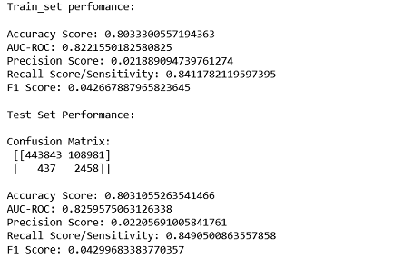
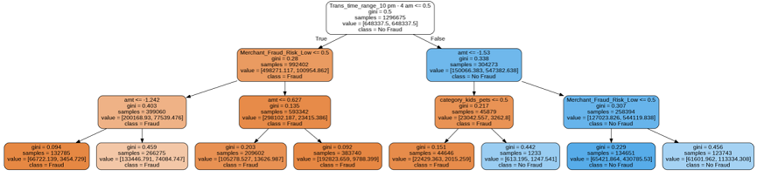
Model Building-contd
Power Transformation performed to Handling Skewness Several models developed under logistic Regression, Decision Tree and Random Forests using the hyper parameter Tuning After building all models observed “The Best model : DECISION TREE” with Max_dept value of 3 was found to be the most cost efficient with decent recall and Accuracy score

Slide 10
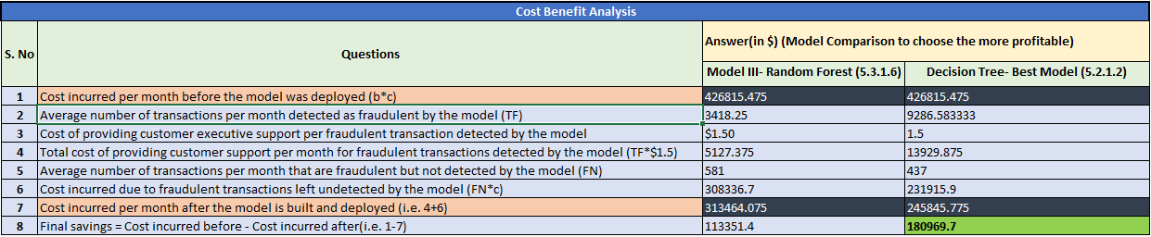
6. COST BENEFIT ANALYSIS

Slide 11

The deployment of this machine learning model i.e the Decision Tree will save $180,969. fraud transactions were happening in early morning hours and late night hours. The Key Variables for detecting fraudulent transactions were Transaction time range 10.00 pm to 4.00 am Merchant fraud risk low ATM Transaction Category kids pets

Slide 12
8. CHALLENGES
The major challenge was model tuning with right values of parameters The most time taken process was Data Pre processing analysis and Feature engineering Working on GOOGLE COLAB was not efficient as the jupyter note book , many times the system was hanged ,it was slow and the model took many hours to get trained

Slide 13

9.Recommendations
Finex must be more vigilant during late nights hours and provide additional security such as: Sending OTP on phone or emails while customer access the internet banking during the purchase . - The highest number of fraudulent transactions happening at grocery Point of Sale followed by internet shopping, must be tracked more proactively, if possible take voice conformation while transforming high amounts mandatory . As the merchants have now been classified as high risk medium or low risk the ones flagged as higher risk could be considered unsafe Any unusual transaction on a card be considered unsafe and immediate follow up with the customers is mandatory

Slide 14
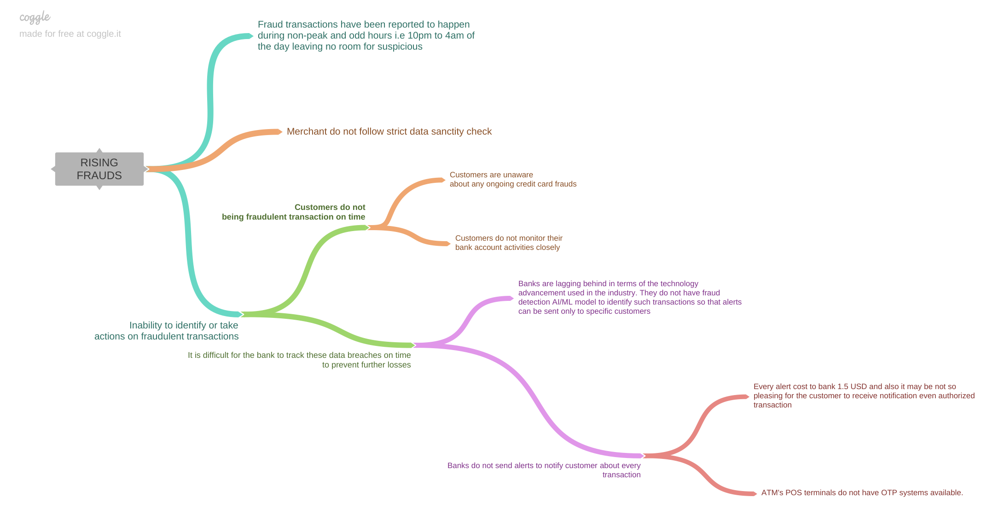
Root Cause Analysis

Slide 15
Thank you
upGrad

